Slide 1
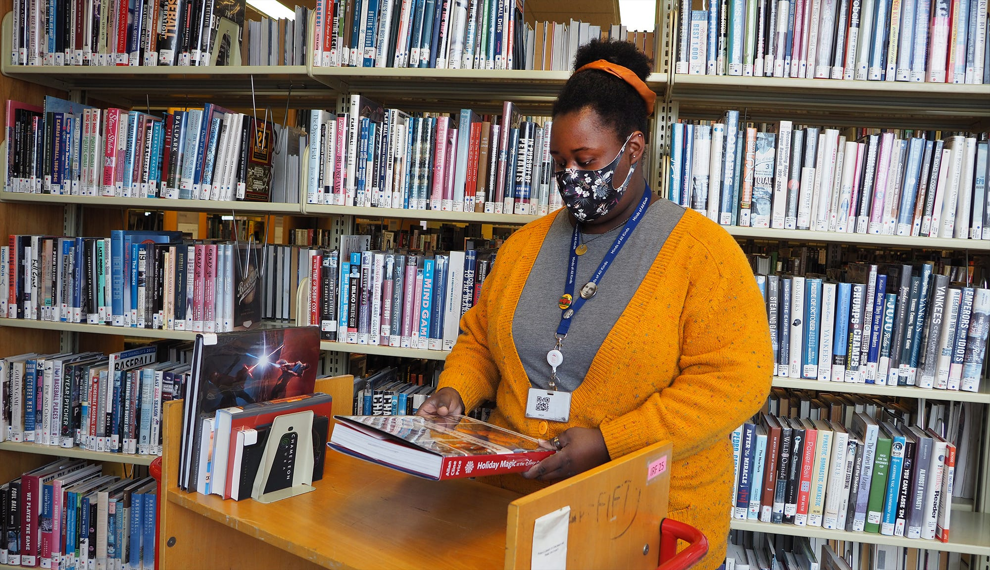
Planning a Next Generation Library Renovation with One Foot Beyond a Pandemic
CHPL Deer Park
Notes:
Introductions (Kate Denier)

Slide 2
Agenda
Project Overview
Rethinking Design
Library Opportunities and Concerns
Design Goals, Values & Strengths
Applying strategies to all project scales
Notes:
I’m Amanda Markovic, Principal at GBBN and have been designing community Libraries for my entire career. For visual and auditory accessibility, I’m a white, cis woman in my 40s, with pulled back brown hair, wearing pants and a black shirt. My pronouns are she/her. I’m excited to be presenting here, in my hometown. Review agenda.

Slide 3
PROJECT OVERVIEW
Notes:
I’m Brett Bonfield, Chief Operating Officer at Cincinnati & Hamilton County Public Library, which we call CHPL.
For visual and auditory accessibility, I’m a white, cis man in my early-50s, clean shaven with greying hair, and I am wearing a suit and tie. My pronouns are he/him.
Information about CHPL can be found in a one-page PDF attachment I’ve uploaded to the OLC conference app for this session and you’re welcome to review it during or after our presentation.
A term on the page that may be unfamiliar: Area of Dominant Influence. It’s from OrangeBoy, which we use for data analysis. It’s used in multi-branch systems to associate customers to the branch they seem likely to use most often.

Slide 4
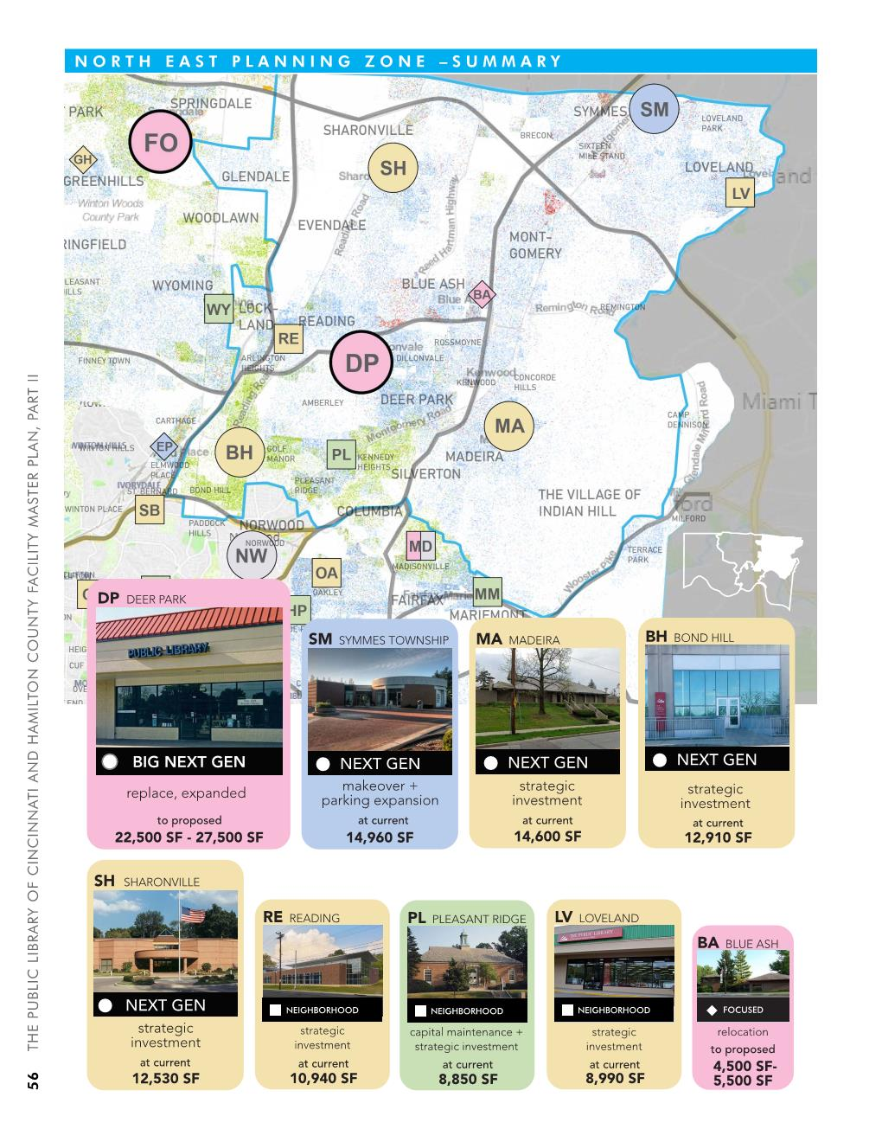
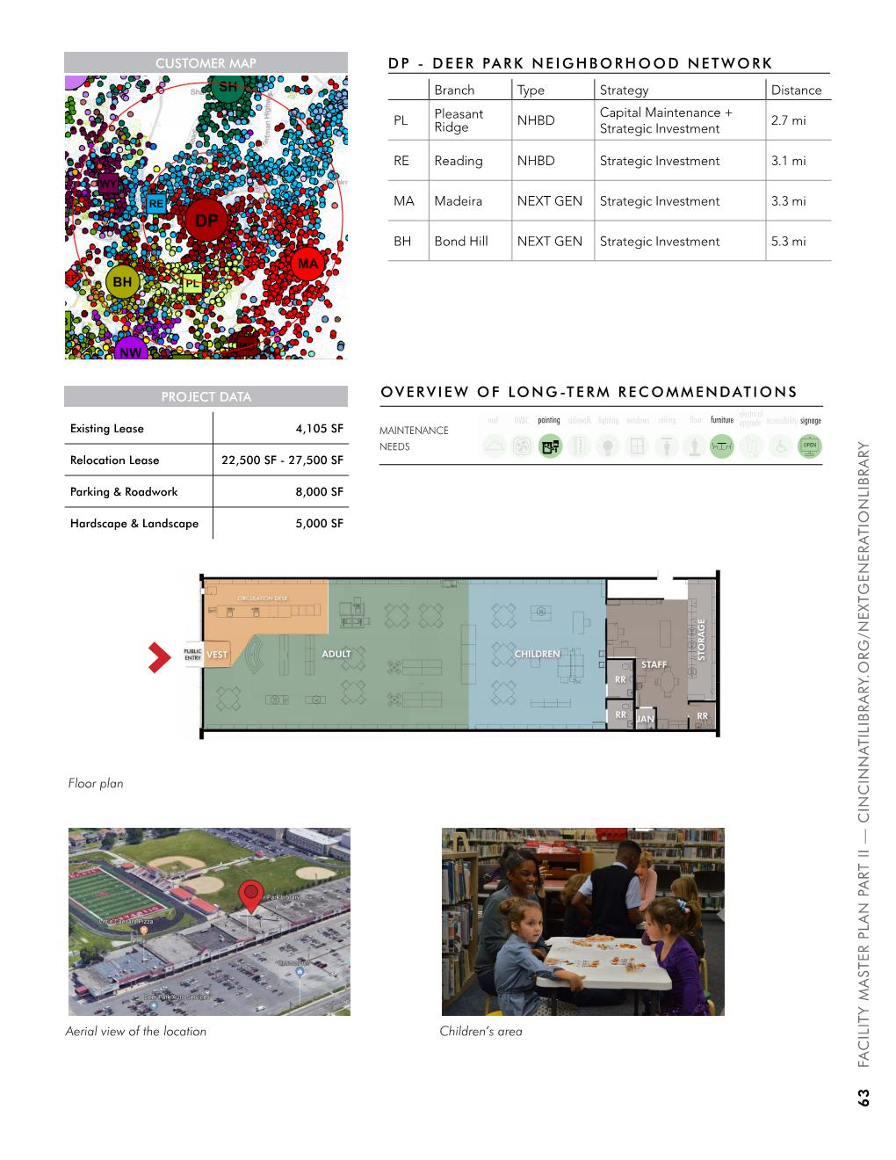
Notes:
This is the Deer Park Branch page from CHPL’s Facilities Master Plan, which is easy to find on our website.
We released it in 2019, just before the pandemic.
It shows where Deer Park is located relative to other branches and calls for it to be a Big Next Generation Library.
The Facilities Master Plan describes how we’ll allocate a $190 million ten-year levy
It took well over a year to develop, and included multiple listening sessions in every community we serve and interviews and surveys with thousands of customers.
Again, check the one-pager for more details.

Slide 5
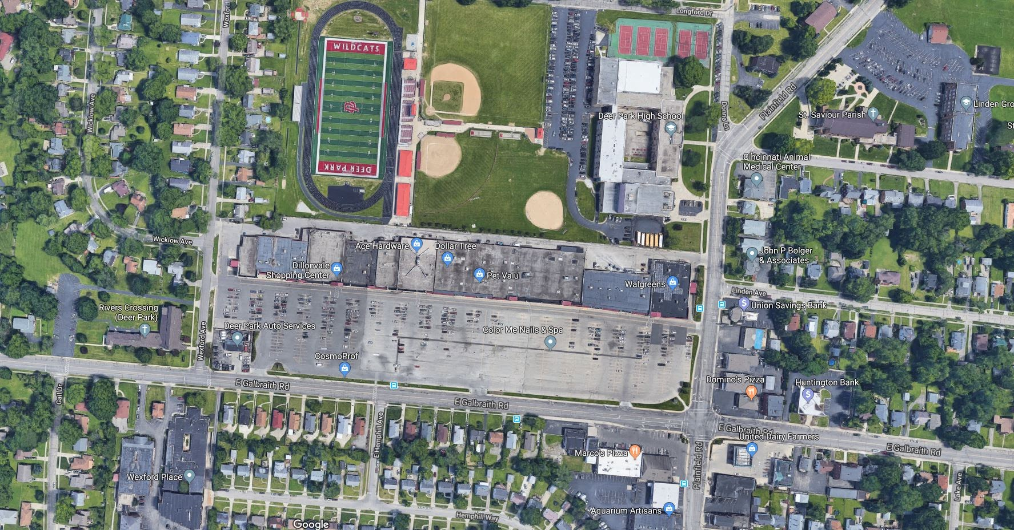
Notes:
The DillonVale Shopping Center presented us with a great opportunity to build our largest branch.
Rents in the strip mall where it is located were reasonable, parking was plentiful, and it’s next to a school, situated in diverse, densely populated area of the County, and it’s two miles from the area’s busiest shopping mall (the one with the Nordstrom’s and Trader Joe’s and a Whole Foods).

Slide 6
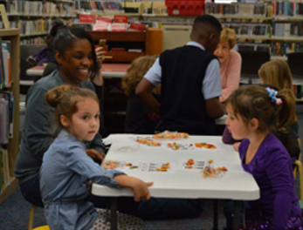
EXISTING LIBRARY
Notes:
The existing library space is outdated and small — and also beloved by its community. The listening session in Deer Park had the most participants.
The branch is one of the busiest, per square foot, in the system.
There were plenty of reasons to re-invest.

Slide 7
Dillonvale Shopping Center
Notes:
So we’re moving a few storefront over,, to a former TJ Maxx space.

Slide 8
Notes:
Look familiar? Anyone remember the jingle? (“Get the max for the minimum…”)

Slide 9
Notes:
This is how the interior of a denuded TJ Maxx looks from the side, near the pre-existing bathrooms and office space.

Slide 10
Notes:
And this is how it looks from the back.
We thought it seemed like the perfect space to build the type of library the community dreamed about.
CHPL’s first Big Next Generation Library.
We issued an Request for Quotes from architects, found a design partner that we trusted

Slide 11
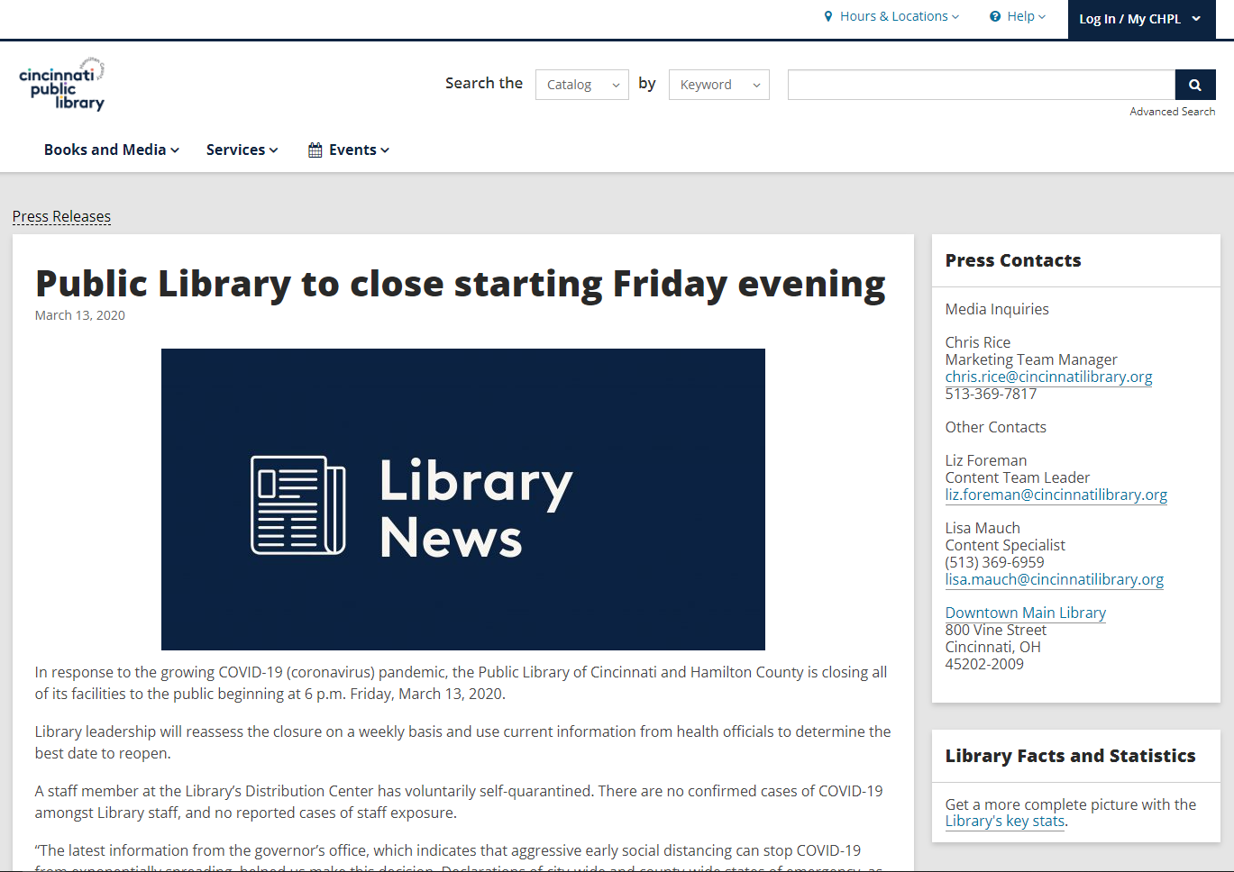
And then…
Notes:
The following Monday we had responses to our RFQ due for the design of the Deer Park Library

Slide 12
RETHINKING DESIGN
Notes:
When we were awarded this project, it was one of our first to begin during the pandemic and at our kick-off meeting, the library asked how the design of this library will respond to the pandemic, and really this was a question we were getting on all of our projects, but we did approach the project differently with this idea in mind, what does it mean to truly consider a design that ensures a safe library experience to meet the needs of a pandemic but how that space can be resilient enough to also respond to the needs of the community over time such as a poetry reading, new technology or even as a food pantry.

Slide 13
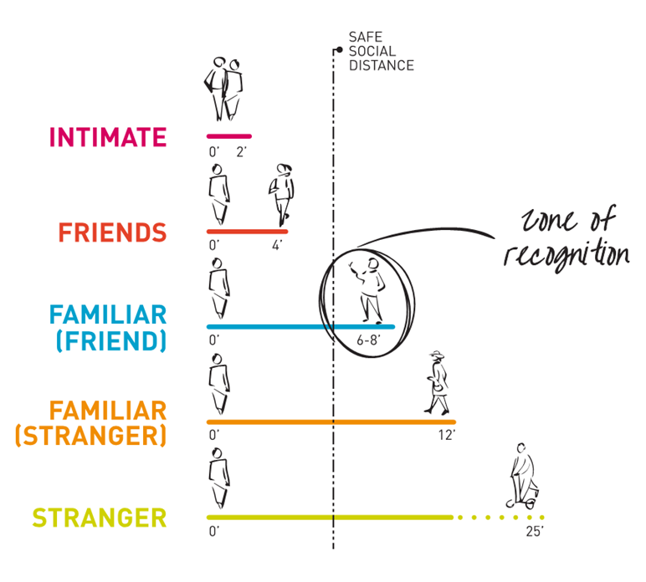
Notes:
We came into this knowing a few things. Before the pandemic, we knew that 47% of Americans always or sometimes feel alone or left out, as we were getting deeper into the pandemic, this was only increasing. Libraries are crucial in maintaining the social and cultural resilience of a community. We reminded ourselves that relationships can be created during this time, that even with 6-8’ of spacing, we become familiar with one another. Coffee shop anecdote

Slide 14
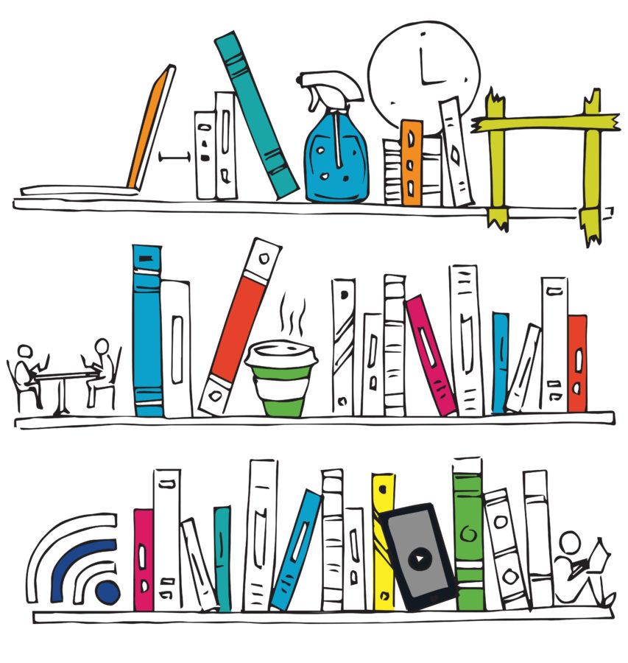
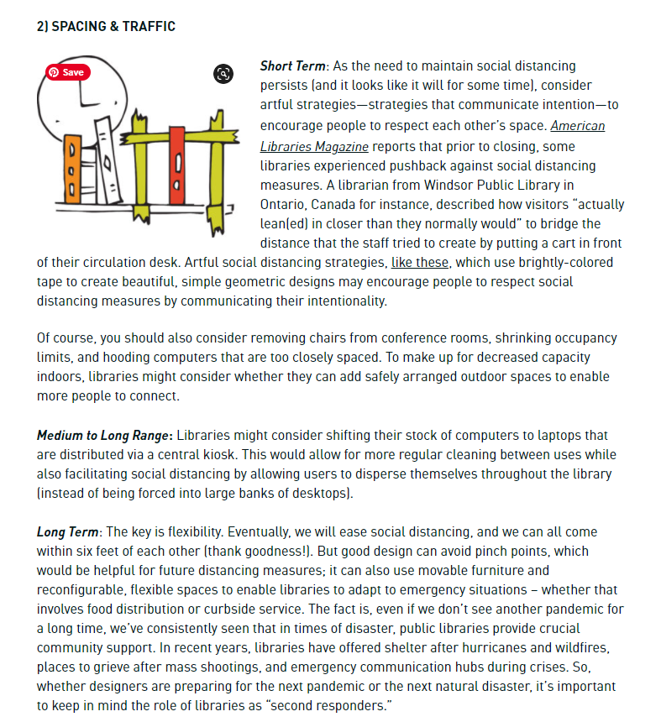
Notes:
We also wanted to utilize our skill sets, understanding of space and surfaces, in any way we could. We identified ways in which libraries can react in hopes of them reopening. Thinking of short-, medium- and long-term solutions. We immediately identified the need to design flexible spaces

Slide 15
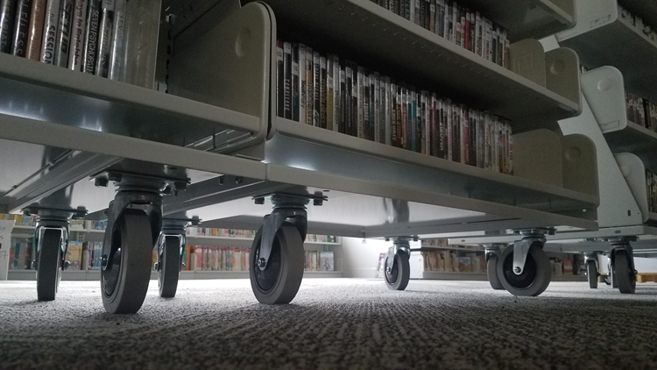
FLEXIBILITY!
Notes:
this is key to accommodate many programs, and programs that change – due to the need for density, or possibly distance and still allow people to feel comfortable and safe in the space. This allows for a range of activities – while maintaining the visual and acoustic needs for each type of activity.

Slide 16
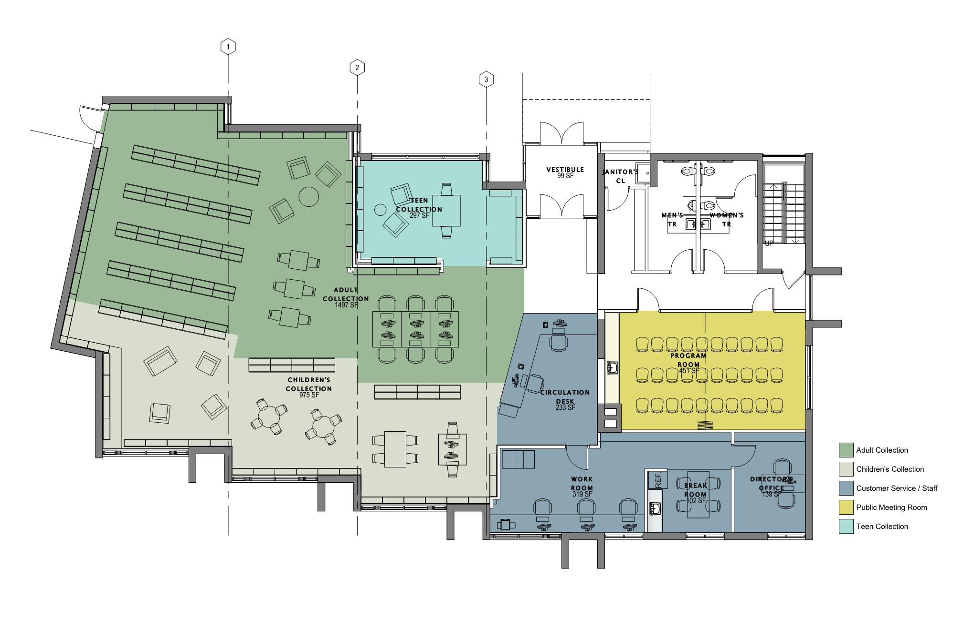
BBPL – 6,000 sf Library
Notes:
At the Baldwin Borough Public Library, we designed with flexibility in mind…but for a very different reason. This small library space had several constraints with load bearing walls and limited funding. The community room is limited in size but can be subdivided to create small meeting rooms or tutoring rooms. Like all libraries, the ability to bring the community together for larger events was critical, so we struck a balance between fixed and mobile furniture and shelving. the opened a year before the pandemic.

Slide 17
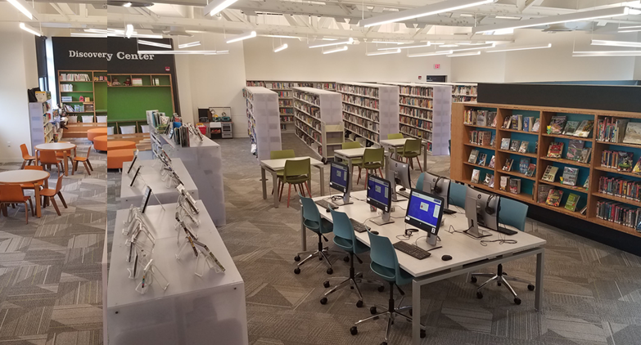
Notes:
The space can function as both a library, with shelving, spaces to play and socialize

Slide 18
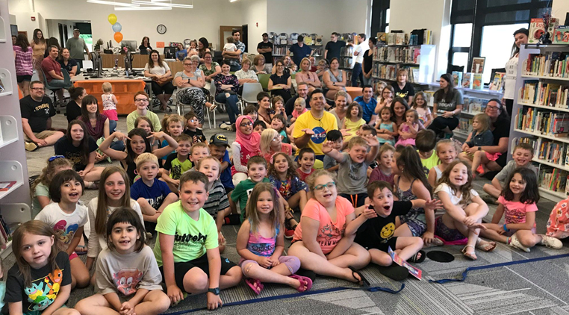
Notes:
and a gathering space for karaoke night, summer reading program kick-offs! as BBPL reopened amid the pandemic, it was very easy for them to safely serve the community by relocating shelving while the community room became a food pantry.

Slide 19
Notes:
But you can’t what we did at BBPL does not scale well, an entire library on casters would have appeared unorganized and chaotic, where the intention of being welcoming and a place of respite would have been lost.

Slide 20
FLEXIBLE AND ADAPTABLE
Notes:
a balance between movable furniture that allows the space to be flexible within a given day but also with reconfigurable spaces to enable the library to adapt to changing programs or as second responders as you often are.

Slide 21
OPPORTUNITY CONCERNS
Notes:
When there’s a crisis, you don’t abandon everything you know.
What you do Instead is return to your core principles.
The seeds that you cultivated before the crisis are the seeds that you cultivate during and after the crisis.
Your values remain the same, even if you need to transplant them to a different pot.

Slide 22
WHAT WE HEARD
COMMUNITY LISTENING SESSIONS
Develop dynamic, engaging, and inclusive spaces for youth services.
Delineate space by activity with particular focus on increasing access to technology and social spaces for community.
Branch design should reflect the diversity of community’s culture and ages.
Consider offering Sunday hours to offer more inclusive service.
Notes:
What we heard in the listening sessions and the reason we decided to build our first Big Next Generation Branch in Deer Park didn’t fundamentally change.
The community wanted us to build on our innovative and successful youth programs
They wanted greater access to technology and more social spaces
They wanted a branch where the design and service hours reflected the increasing diversity of their community.
This included physical, neurological, cognitive, and financial accessibility, along with race, ethnicity, language, nationality, religion, and increasing numbers of both preschool customers and customers who are seniors.

Slide 23
WHAT WE WANTED
Mix of seeing people and collection within any point in the library This is a Library; not a warehouse for books or a community center.
Feels organic without being chaotic
Sense of prospect and refuge.
Toilet rooms: accessible and safe, for customers and staff
Notes:
We needed the space that served these needs to feel like a vibrant, welcoming place that read as a library as soon as you walk in the door.
We wanted it to be a destination, a place with Wow factor that you also wanted to return to over and over when you wanted a place to think or gather or explore.
That meant it had to be safe
It also couldn’t break our budget to staff appropriately, operate, or maintain.

Slide 24
DESIGN GOALS AND VALUES
Notes:
complexities of design for any project

Slide 25
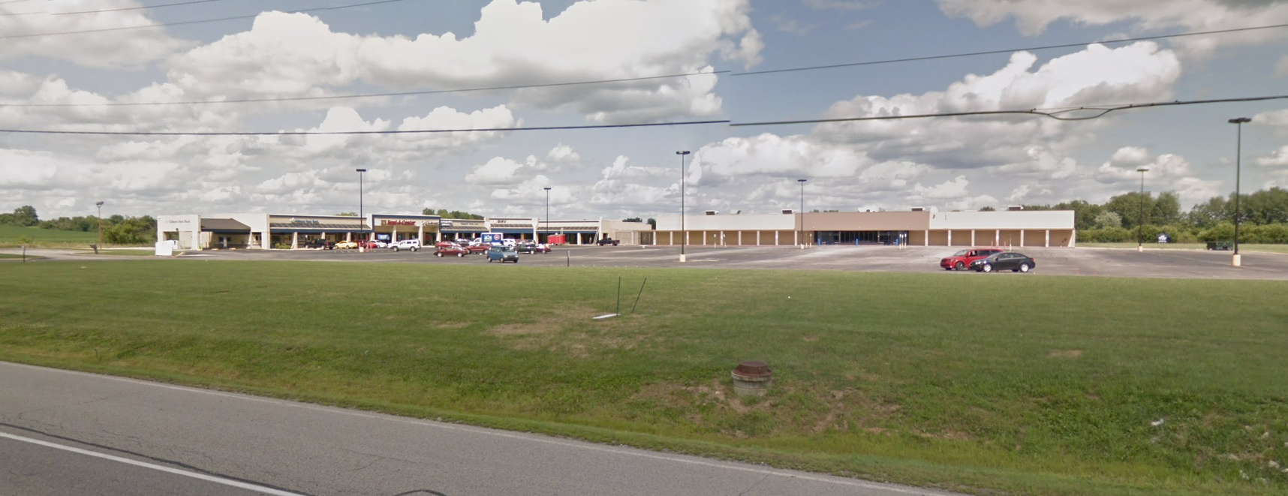
Sustainability
https://libguides.ala.org/SustainableLibraries/Green
https://sustainablelibrariesinitiative.org/
Notes:
Now a discussion on sustainability can be a whole different session but you may know that the American Library Association has several resolutions on sustainability and the role libraries play in the community and within their buildings to fight climate change. They also provide resources for curriculum development, collections, exhibits, events, advocacy, communication, and library buildings and space design. But Libraries are inherently sustainable as their resources are shared within the community and provided to all. You do not have to have a LEED certified building to be sustainable, libraries can improve their environmental impact through both sustainable operational practices in their day to day functions, and green buildings which minimize consumption of resources during manufacturing and construction through operation. Broad examples are: new buildings, consideration of the form and orientation, compact buildings allow for better natural light distribution. For your interiors, proper ventilation, providing a variety of space and healthy material selections; and connection to place: local and natural materials, local vegetation. SHOW WEBSITES!!
We are seeing more and more vacant big box stores; they are in all communities. The adaptive reuse of these spaces is the most sustainable type of building you can have. Existing buildings have a large amount of embodied carbon. This is a former Super Walmart in rural Indiana

Slide 26
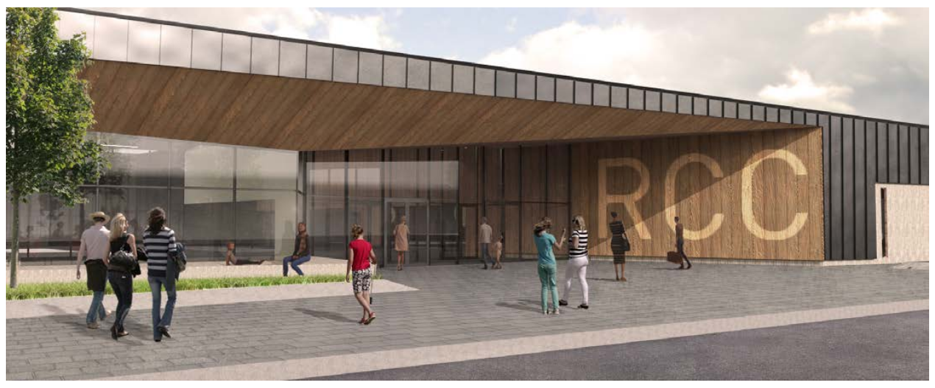
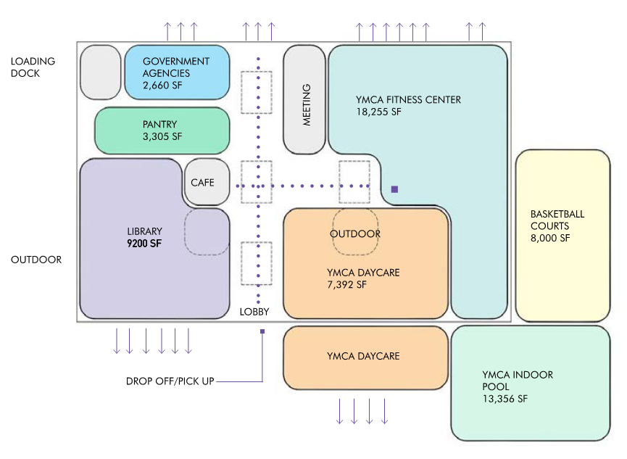
Adaptive Reuse
Notes:
This community was able to secure grant funding to transform this very large space into an asset. It will hold a food pantry, a community library, government services, and a YMCA. It is incredible to see investment like this and take this opportunity of transforming it into a vibrant community civic space.

Slide 27
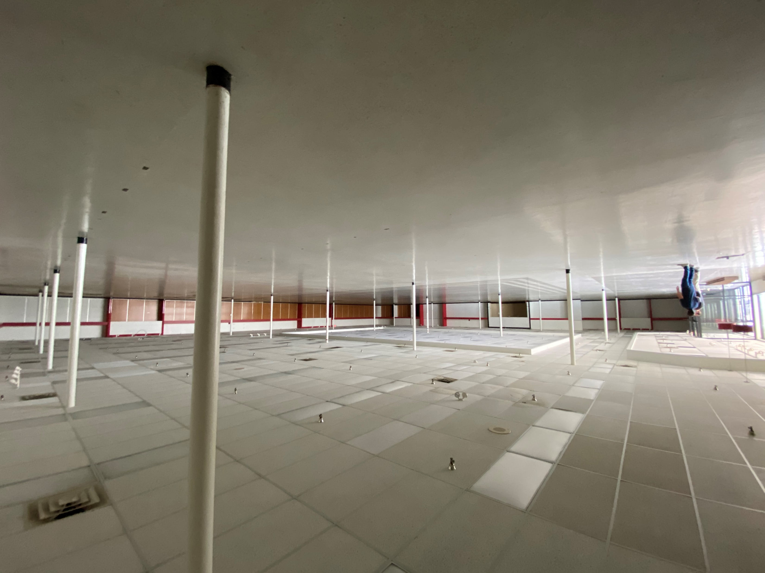
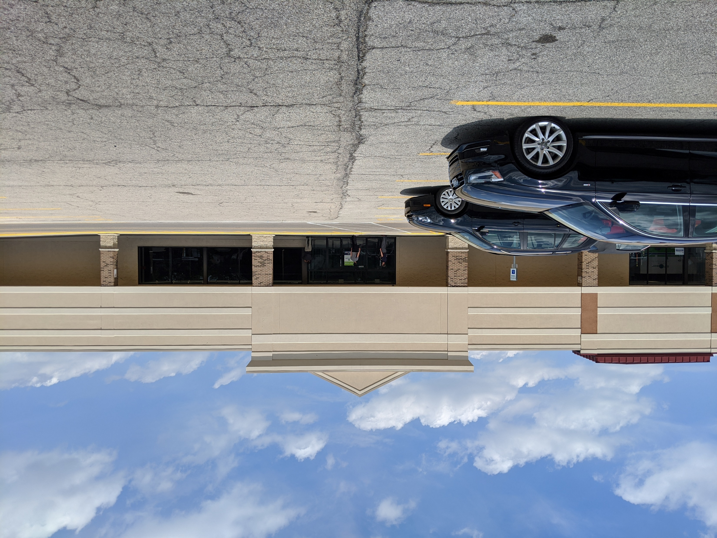
Adaptive Reuse
Notes:
but it is critical that these spaces are transformed…to be a home for the community and not feel like you are stepping into a familiar retail space that we’ve all been to before. There must be a sense of place.

Slide 28
Vision
The new home for the Deer Park Next Generation Library will provide a place that welcomes, supports and inspires the community, sustaining the mission to connect people with the world of ideas an information. It will be a place that encourages the community to gather, connecting with each other and with essential services.
Objectives
Transform the former TJ MAXX to become an accessible, inviting and vibrant information and community hub.
Flexible design that adapts to meet the needs of the community and anticipates future service, programs and technologies.
Invest in the most immediate community while also attracting people from the larger, more diverse North East zone where a full range of services are provided from traditional to emerging.
Engage a broad customer community, from toddlers to older adults, with spaces that range from collaborative areas and large program rooms to spaces for exploration and quiet focus.
Notes:
As mentioned earlier we started this project being very mindful of the of the pandemic we were in. and developed a Vision and a series of objectives to serve as our guiding light through the entire design process, from early conception to construction closeout. READ/ PARAPHRASE objectives

Slide 29
“For the curious, social learner, The Public Library is the catalyst for ‘learning without limits’ in the community”
Notes:
And to make things more interesting, upon commencement of design, the library rolled out their new brand strategy and attributes. This idea of ‘learning without limits’ as they state: brings a variety of diverse individuals together for a unique experience every time. The library provides the guardrails to explore ideas and make connections, while still allowing for individuals to pave their own path. This is how CHPL continues to provide its resources and expertise and the space needed to support this through adaptability and thoughtful placemaking.

Slide 30
Notes:
We began to develop a plan that was welcoming, evokes curiosity and is delineated enough to allow for individuals to explore on their own terms, to achieve the vision and objectives and to meet the desire of ‘learning without limits’. At the center in yellow is a marketplace similar in concept to the previous images. By placing a centralized hub of activity, it allows for a barrier free entry in that when you enter, there is ability to gain bearings, understand the layout and where you can get help. This space also allows for the kind of flexibility necessary for the resources to shrink and flex to meet the needs of the community where there is an overlap between the marketplace and the adult/children/teen areas.

Slide 31
PLAN LAYOUT
Notes:
But like any process, we certainly didn’t get it right immediately, the marketplace wasn’t as flexible as we had hoped

Slide 32
3D VIGNETTES
Notes:
we also wanted this space to be a place where very large events could occur and really wanted to include stadium style seating to emphasize this.

Slide 33
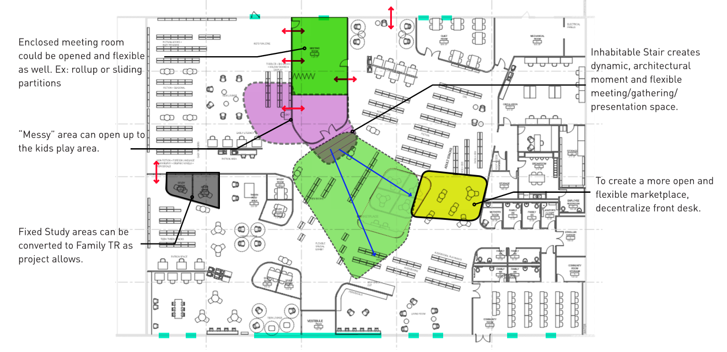
PLAN OPPORTUNITIES
Notes:
to Brett’s point, toilet rooms were also not meeting the libraries needs, there weren’t any in the children’s area, there also weren’t the necessary connections between spaces such as the children’s to teen

Slide 34
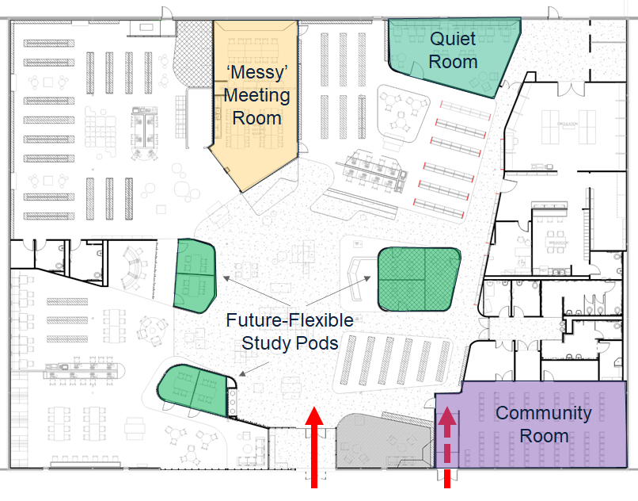
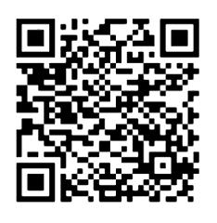
Take a look!!
Notes:
in the end, we landed with a design that met all goals. Utilizing fixed elements to define spaces while maintaining adaptability within the fixed spaces (messy meeting room, pods, community meeting room, and flexibility with movable furniture in the marketplace. If you can, take a look at the space yourself using the QR code.

Slide 35
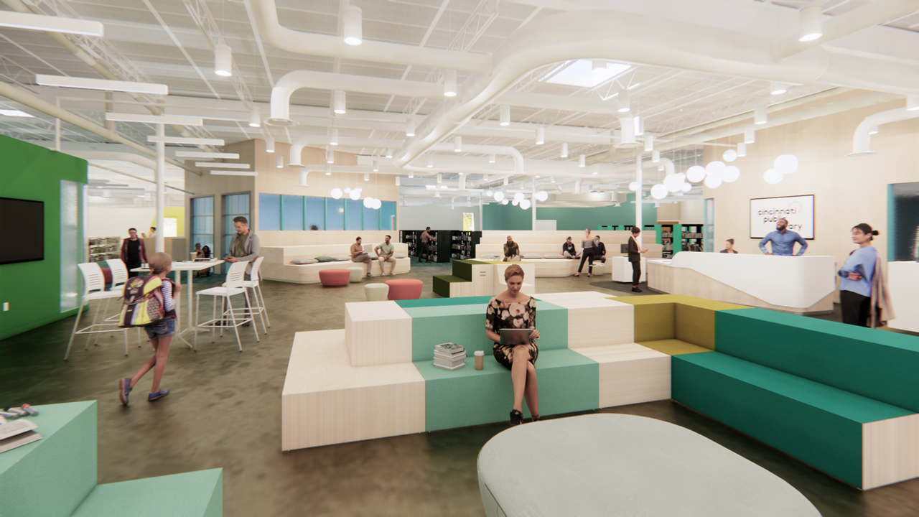
Notes:
a space that would meet the needs of each demographic. A place that’s playful for its youngest customers, engaging for teenagers and refined for adults that might want some peace and quiet.

Slide 36
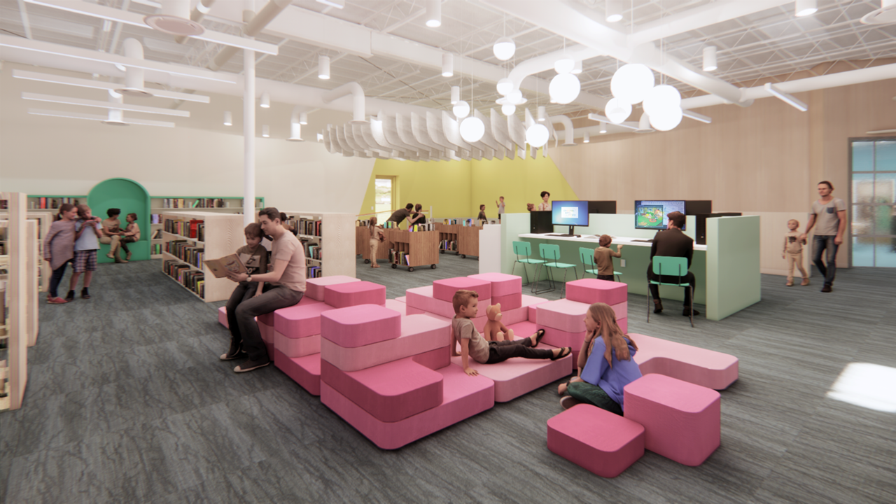
Notes:
children’s area, creating opportunities to play, cozy up with a caregiver to read and a reading corner for smaller programs. the garage doors to the right are part of what we call the messy room, no carpet,

Slide 37
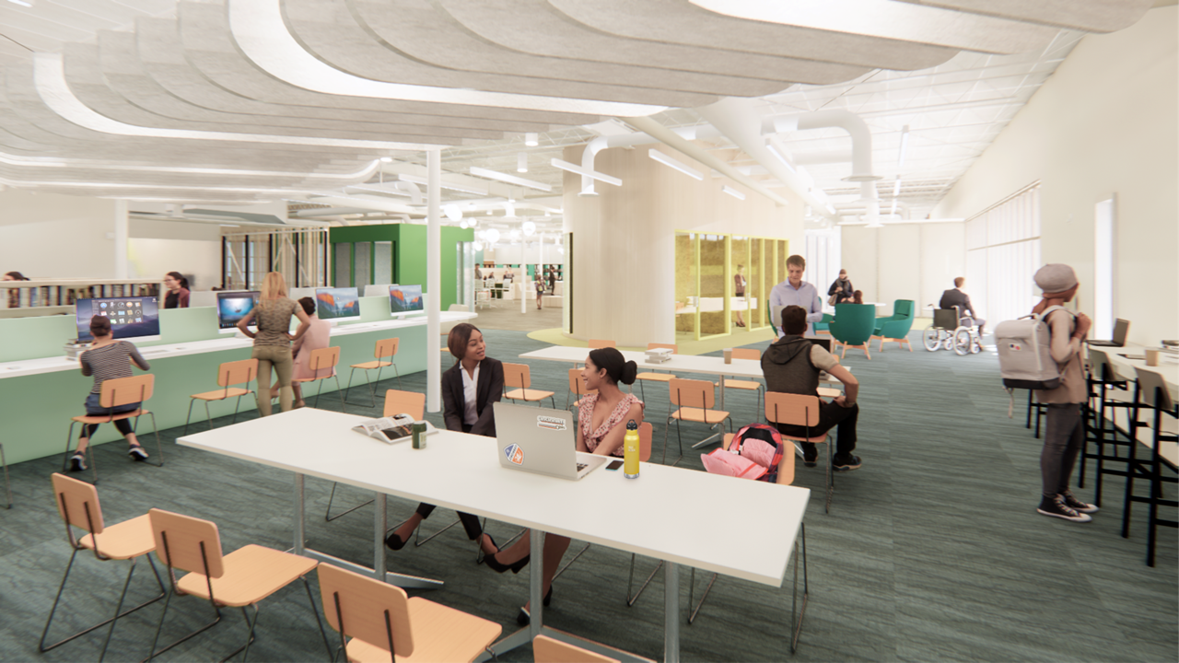
Notes:
teen and tween area, pod, computer space to geek out, space to work on projects together and places to just hang out and socialize

Slide 38
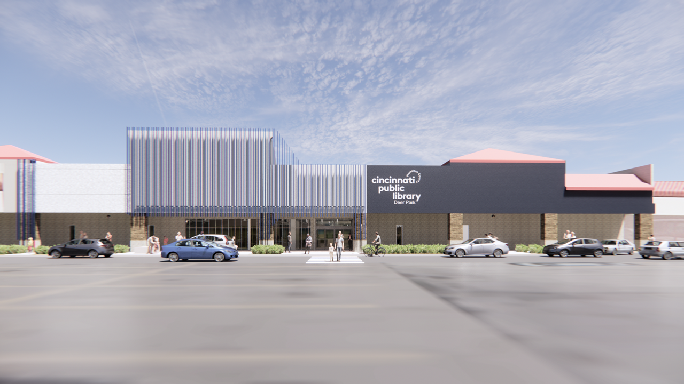
Notes:
for the exterior, we had to work closely with the Mall owner to negotiate the vision of the library with their own interests. The library wanted increased visibility, and awareness of the size of the space. The design also had to meet the libraries budget, so we designed an element that works with the existing structure, utilizing a painted tube that transforms the existing façade to something new and recognizable, I’ll meet you at the flag”. Then utilizing paint to highlight the overall size.

Slide 39
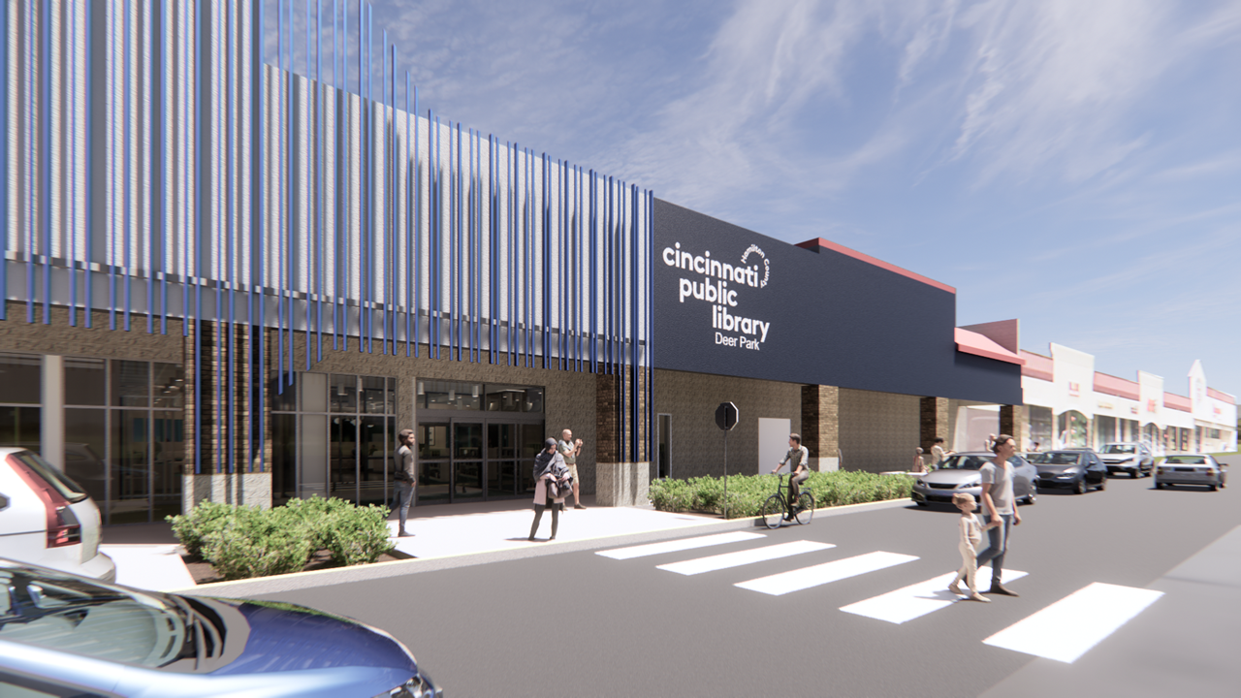
Notes:
We also worked with the civil engineer to redefine the curb to allow for a much safer arrival experience.

Slide 40
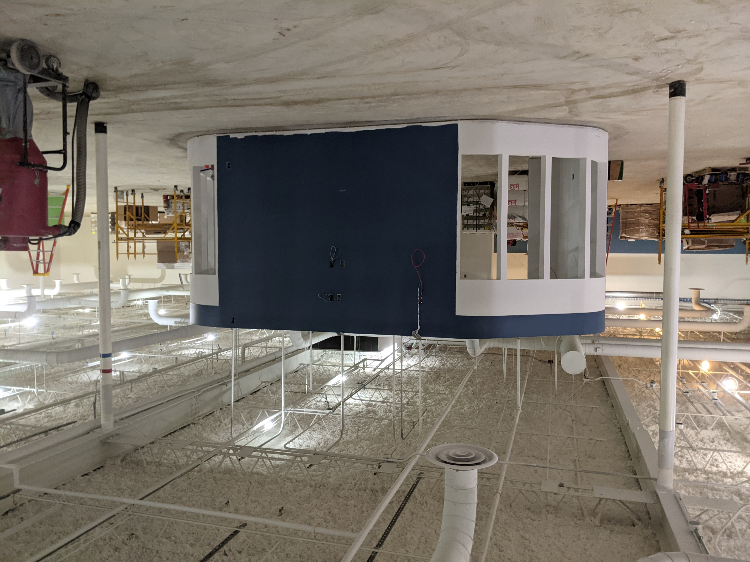
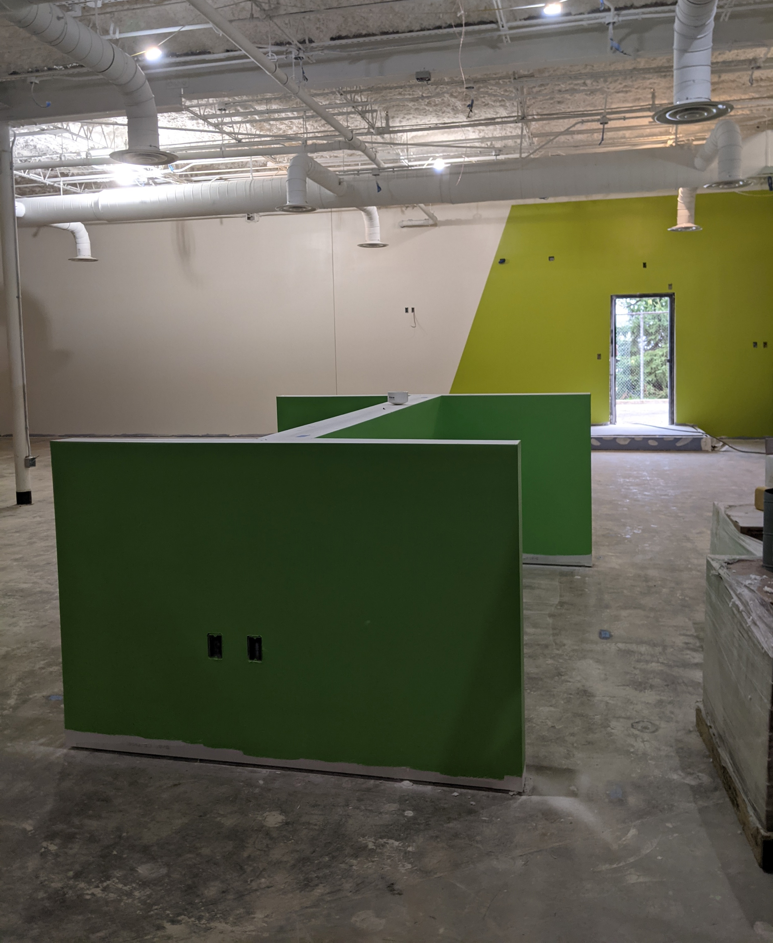
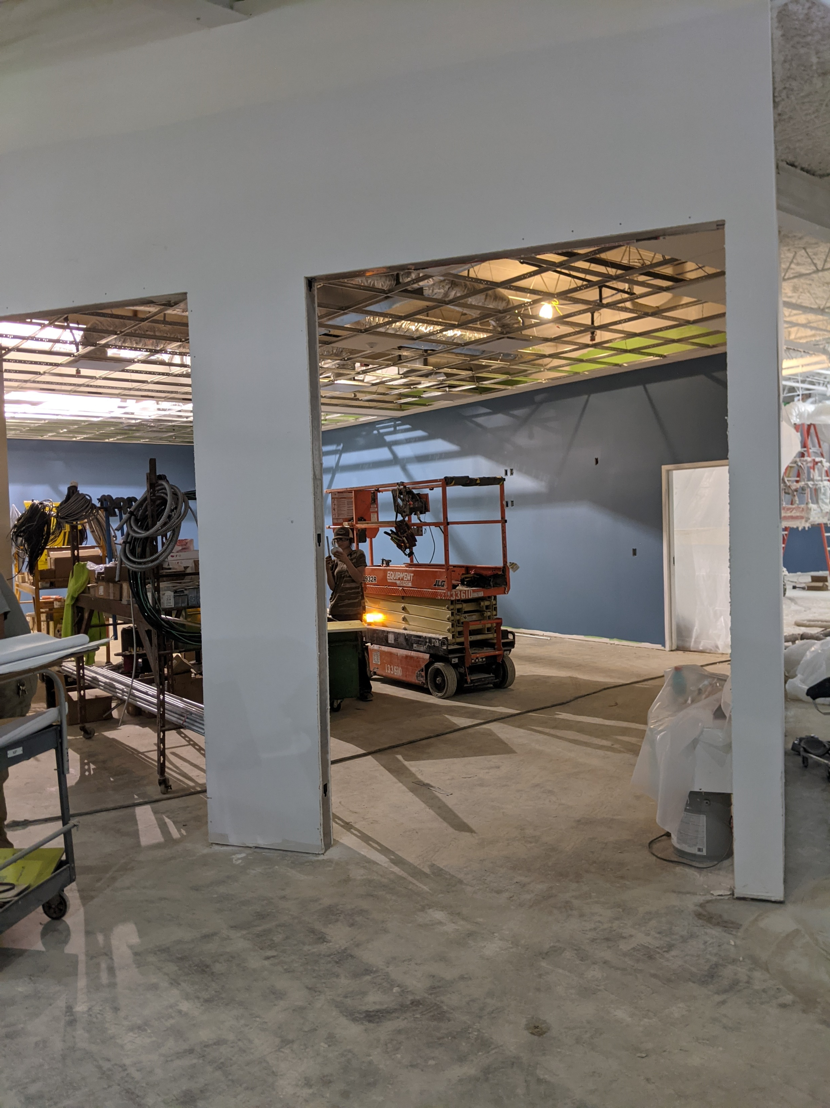
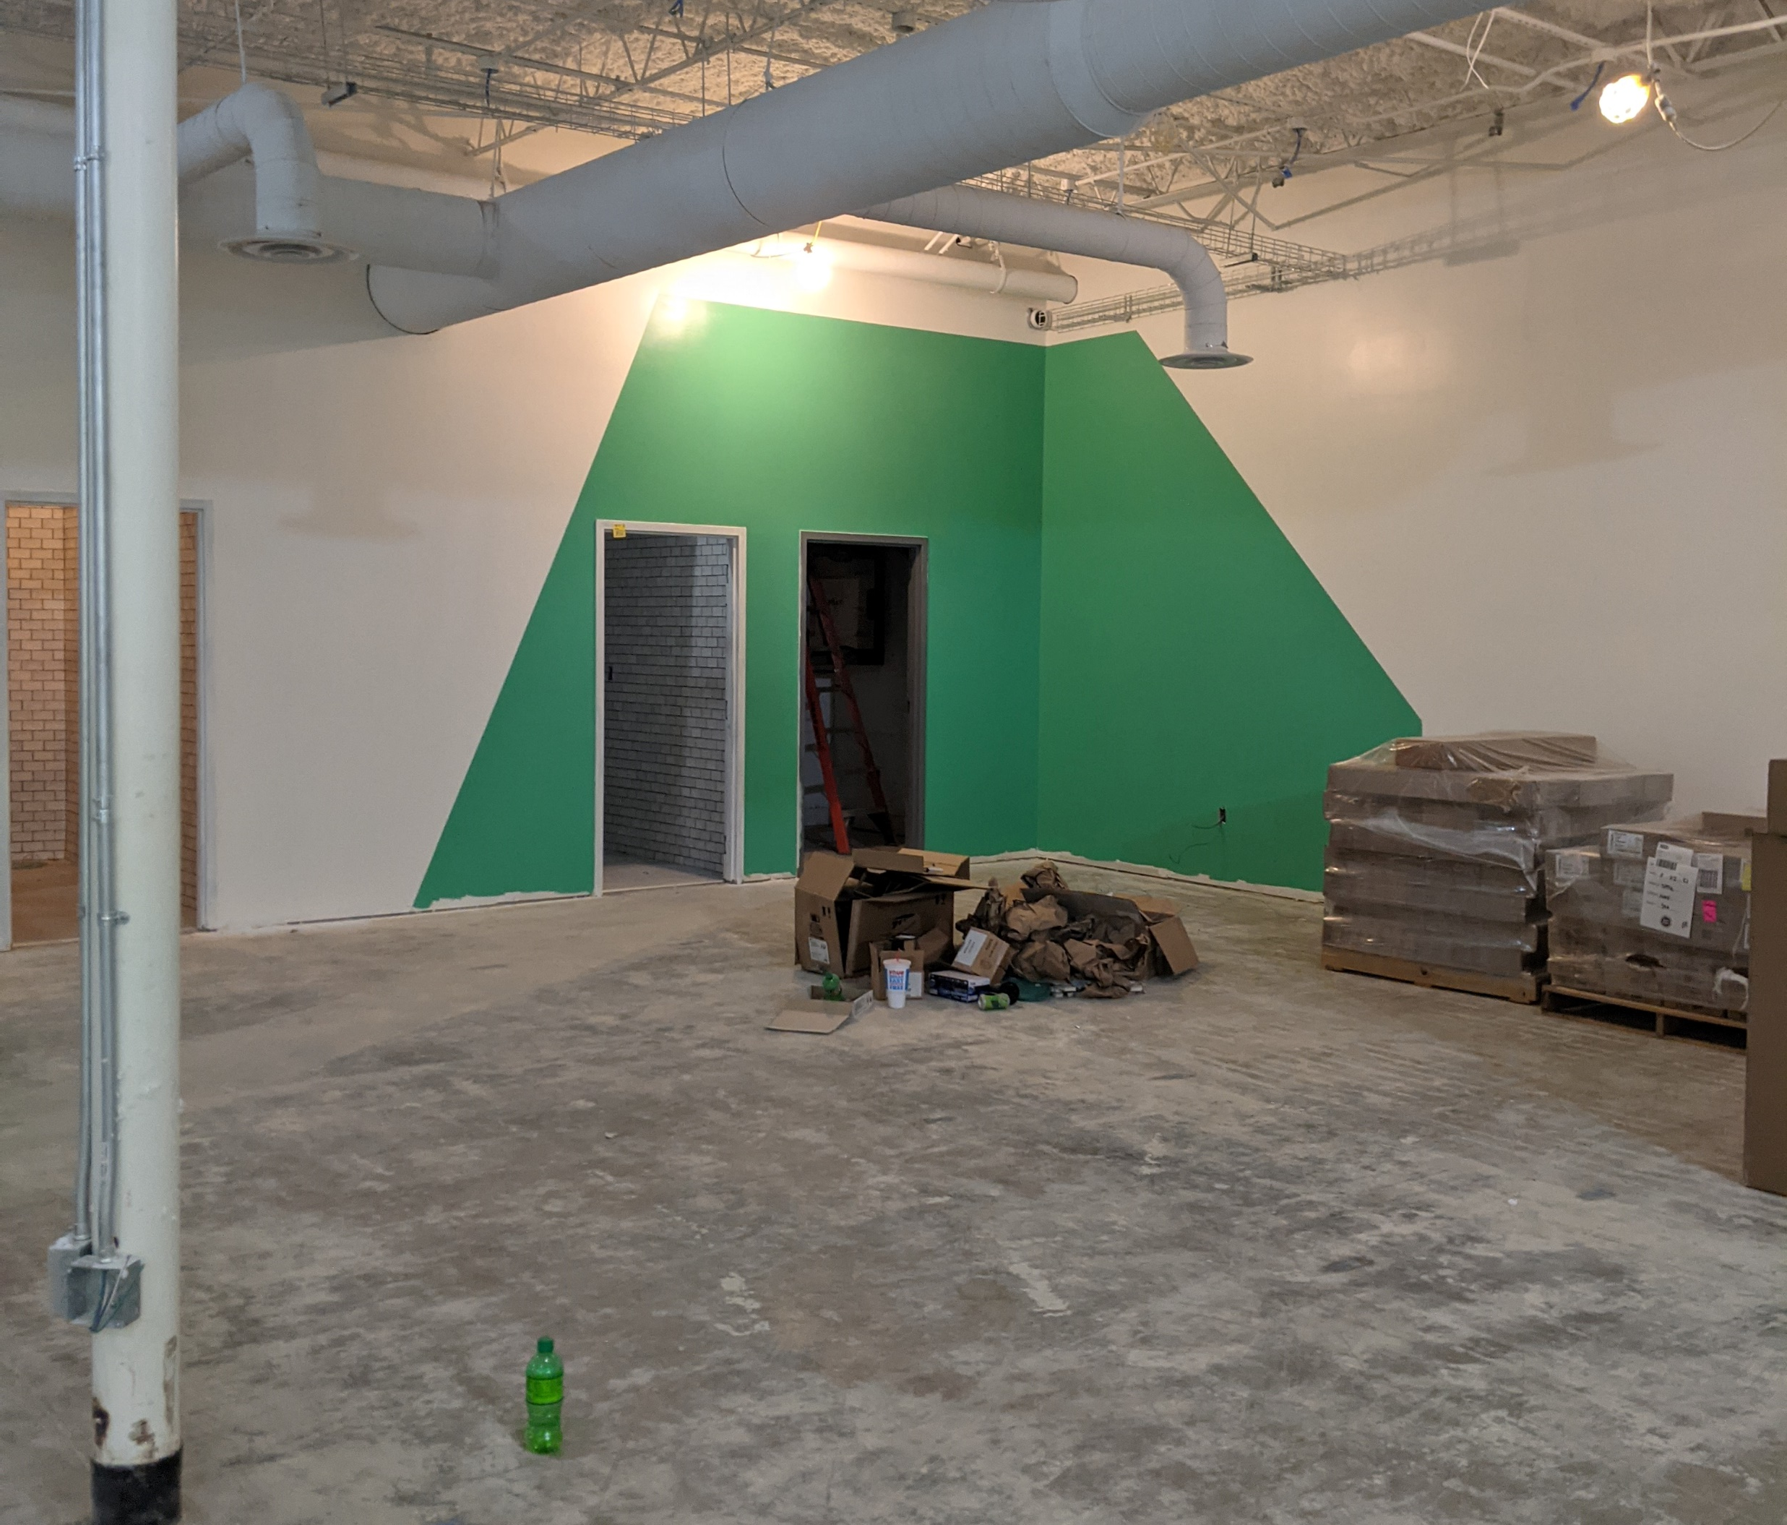
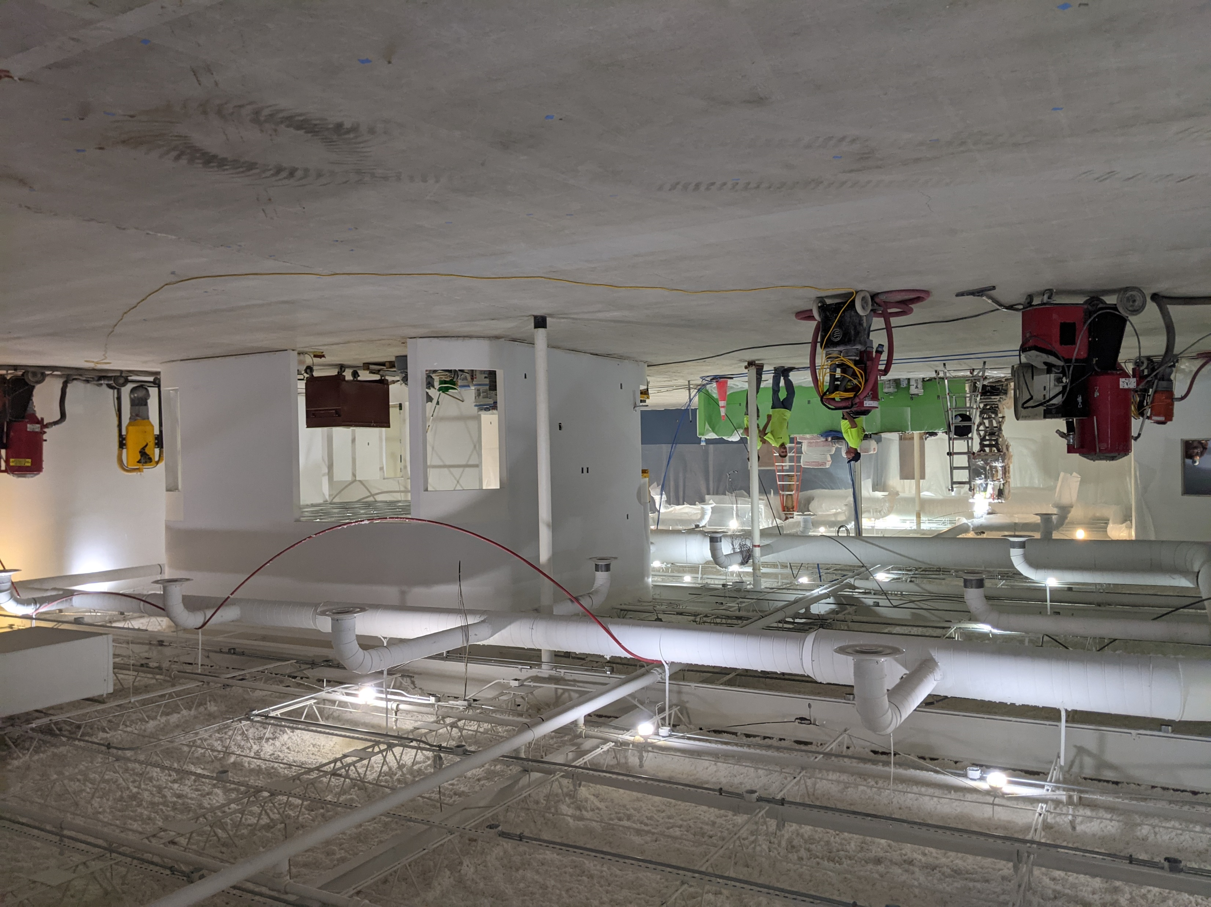

Slide 41
APPLYING STRATERGIES AT ALL SCALES
Notes:
That’s what we have to say about Deer Park, at least for now.
We’ve left time at the end for questions and we hope you’ll have some to ask.
The kindest thing you can do for presenters, far more than applause or compliments, is ask them questions.
We mentioned that we had a chance to work with GBBN on a second smaller project. Deer Park is 25,000 SF. The Madisonville Branch Library is about 9,000 SF.

Slide 42
…what about a small library?
Notes:
The Deer Park Branch Library is a Big Next Generation.
The Madisonville Branch Library is a Neighborhood Library.
Based on extensive conversations with our customers in Madisonville, it has a technology focus.
This is the page from the Facilities Master Plan that describes the Madisonville project.
Coming to an understanding about the type of branch we were creating was pretty straightforward: Neighborhood fit its size and scope.
Technology-focused fit the community’s needs and aspirations.
We also knew we didn’t want a makerspace in the traditional sense.
Makerspaces can be intimidating with steep learning curves, which creates a barrier to access. To figure out how to proceed, we returned to our core values.

Slide 43
VISION
The new Madisonville Library will enhance the community through digital inclusivity. With a focus on emerging technology, the branch will provide hands-on learning opportunities that inspire creativity and collaboration. The branch will be a place for minds of all kinds to connect, create, and collaborate.
Notes:
Just as is our practice, this Vision for the project was developed

Slide 44
CHPL Madisonville
Notes:
But we still didn’t know exactly what the program was, so we developed a series of customer personas to help us all understand how individuals might use the space. We looked at a teen, a caregiver, an entrepreneur, and the very typical, one-time user (just comes in to grab a movie or something on hold). Mapping out how their typical library experience might be enhanced with the addition of technology in the space.

Slide 45
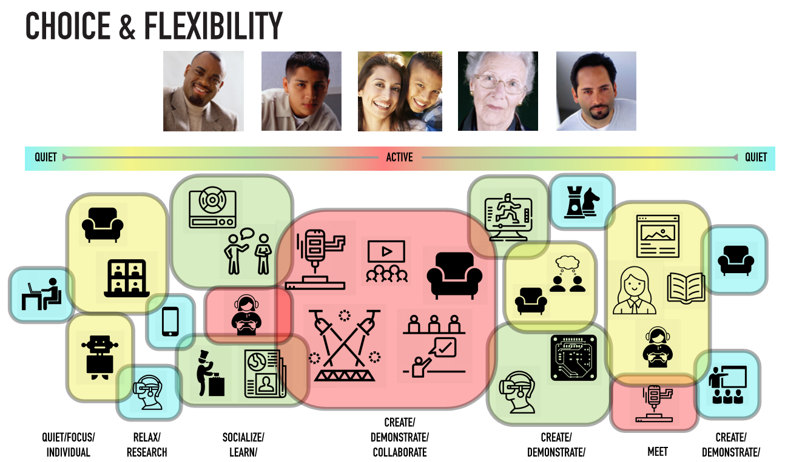
CHPL Madisonville
Notes:
not only did it help us understand the different types of spaces, but to understand the flexibility like individual spaces to experience the technology but also the ability to showcase the technology through demonstrations in a centralized space

Slide 46
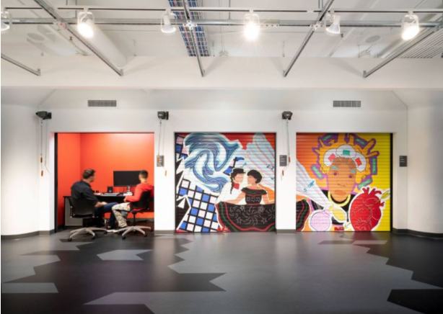
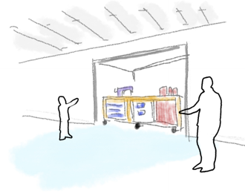
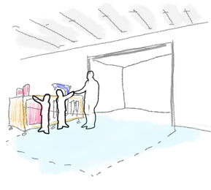
CHPL Madisonville
Notes:
The library also put together an inspiration image board, and we immediately were drawn to an image of a series of garages and how the makerspace could be reconsidered.

Slide 47
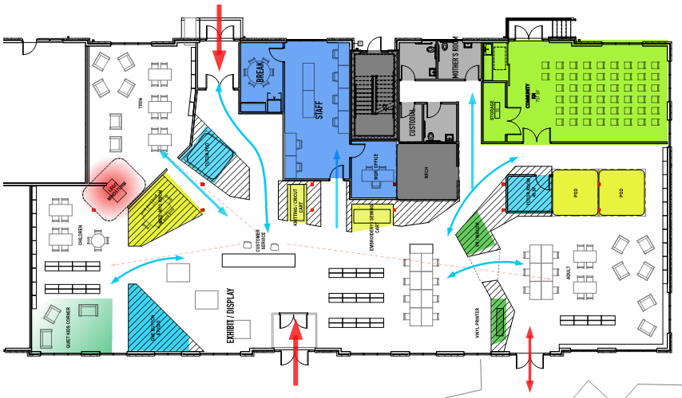
CHPL Madisonville
Notes:
We also were worried about the same issue that the space could easily feel messy and chaotic and didn’t have a sense of space. we organized the library around a central spine that would hold the elements of technology. Again, the Market place is immediately when you enter the space, allowing for socializing, demonstrations, and visibility to the equipment.

Slide 48
BRAND ALIGNMENT
Notes:
we again leaned on the Brand strategy to keep ourselves in check. This space:

Slide 49
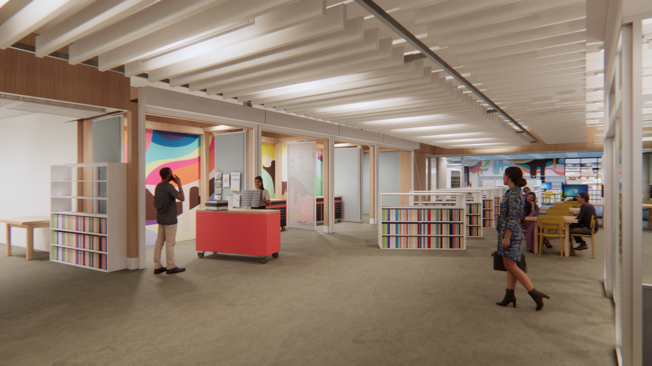
BRAND ALIGNMENT

Slide 50
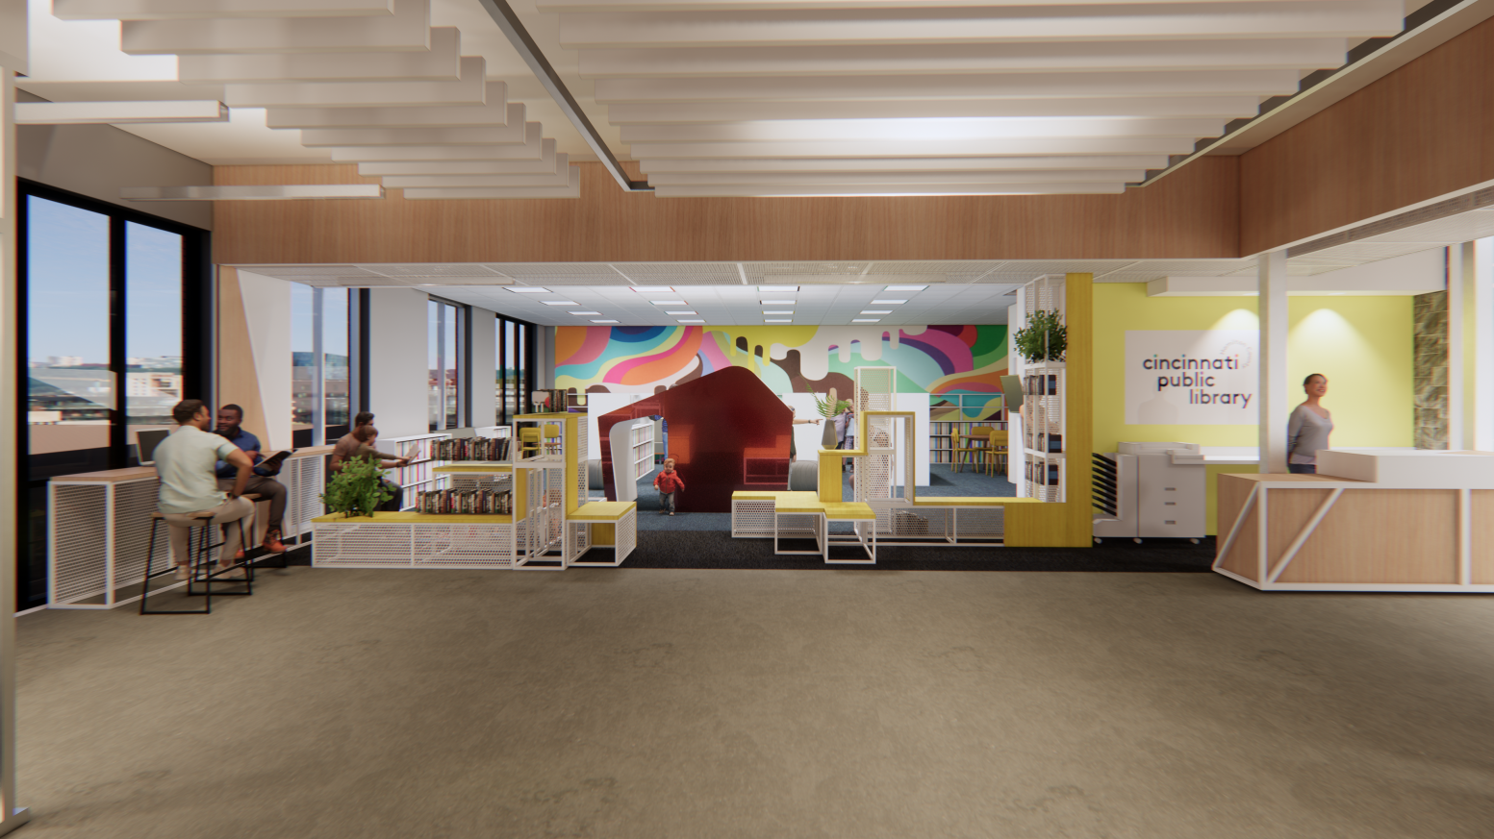
BRAND ALIGNMENT

Slide 51
Q & A

